Slide 1
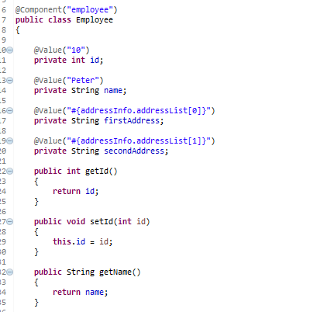
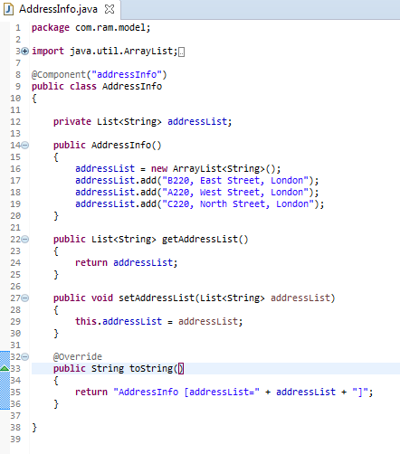

Spring EL Lists-Annotation
…
…

Slide 2
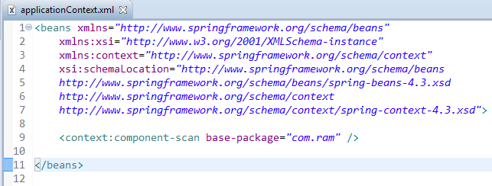
Enable auto component scanning.

Slide 3
